Slide 1



Summarizing the chapter 3 of N I C H O L A S C . Z A K A S’s book
Summarized By: Marwan Algadi

Slide 2

Chapter 3 Understanding Objects

Slide 3


topics
01
02
03
04
Introduction
Defining Properties
Detecting Properties
Removing Properties
05
06
Enumerability
Types of Properties
07
08
Property Attributes
Preventing Object Modification

Slide 4

Introduction
In this article, we'll look at fundamental JavaScript object syntax, and revisit some JavaScript features that we've already seen earlier in the course, reiterating the fact that many of the features you've already dealt with are objects.
An object is a collection of related data and/or functionality (which usually consists of several variables and functions — which are called properties and methods when they are inside objects.)

Slide 5
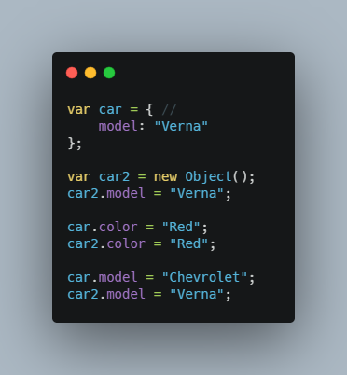
Defining Properties
there are two basic ways to create your own objects:
1- using the Object constructor
2- using an object literal.
For example:
In this example we create car object and model property in it, then created new object using constructer and gave it model property.
Then later in the code we added new property in both objects, then changed the model property.
Any objects you create are always wide open for modification during coding.
But we always can prevent Manipulation by many ways we will learn later.

Slide 6
Defining Properties
Properties are the values associated with a JavaScript object.
A JavaScript object is a collection of unordered properties.
Properties can usually be changed, added, and deleted, but some are read only.(unless we specify otherwise).
When a property is first added to an object, JavaScript uses an internal
method called Put on the object.
The Put method creates a spot in the object to store the property.

Slide 7
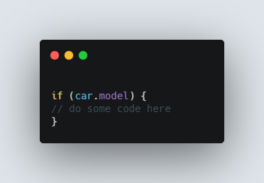
Detecting Properties
we need sometimes to check whether a property exists in the object or not.
There are many ways to check for this situation,
For example:
This code isn’t unreliable, because If car.model is 0 or empty string (“”), then the condition will not be met even though the property exists if

Slide 8
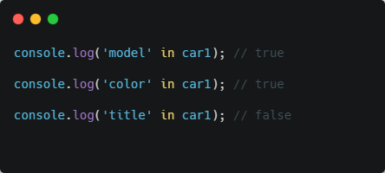
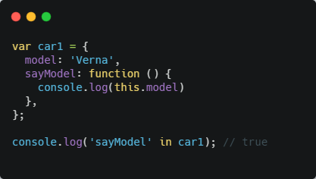
Defining Properties
A more efficient way to test for the existence of a property is with the in operator.
The in operator checks to see if the given property exists in the hash table or not.
Methods are just properties as well, that reference functions,

Slide 9
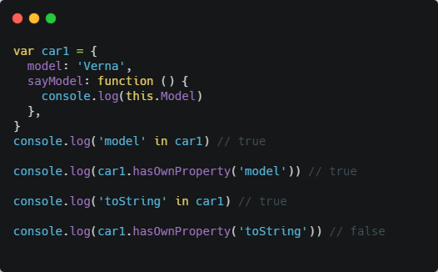
Defining Properties
The in operator is an inbuilt operator in JavaScript which is used to check whether a particular property exists in an object or not. It returns Boolean value true if the specified property is in an object, otherwise it returns false.
toString is true in first console.log because it's in prototype built-in methods

Slide 10
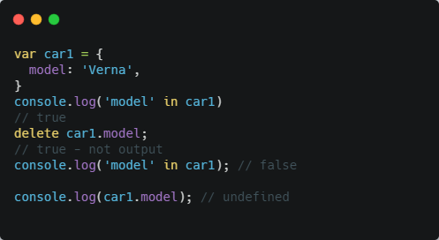
Removing Properties
Simply setting a property to null doesn’t actually remove the property completely from the object, it’s still exist but the value if it will be null.
The JavaScript delete operator removes a property from an object; if no more references to the same property are held, it is eventually released automatically.
Also we can prevent deleting and manipulating the object, we will discuss this later.
Note that attempting to access a property that doesn’t exist will just return undefined

Slide 11
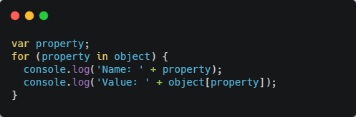
Enumerability
Enumerable properties are those properties whose internal enumerable flag is set to true, which is the default for properties created via simple assignment or via a property initializer. Properties defined via Object.defineProperty and such default enumerable to false.
Enumerable properties show up in for...in loops unless the property's key is a Symbol. Ownership of properties is determined by whether the property belongs to the object directly and not to its prototype chain

Slide 12
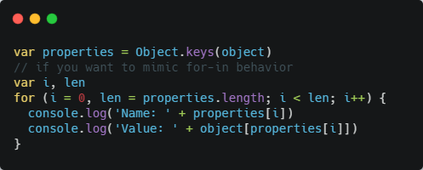
Enumerability
The Object.keys() method returns an array of a given object's own enumerable property names, iterated in the same order that a normal loop would.
A for loop is then used to iterate over the properties and output the name and value. Typically, you would use Object.keys() in situations where you want to operate on an array of property names, and for-in when you don’t need an array.

Slide 13
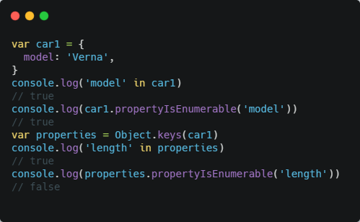
Enumerability
Keep in mind that not all properties are enumerable. In fact, most of the native methods on objects have their Enumerable attribute set to false.
You can check whether a property is enumerable or not by using the propertyIsEnumerable() method, which is present on every object.
In this ex the model property it enumerable and it’s custom property defined in car1.
The length property in properties array isn’t enumerable because it’s built-in method in Array.prototype

Slide 14
Types of Properties
There are two different types of properties:
1- data properties: A data property contains a single location for a data value. A data property has four attributes: Configurarable, Enumerable, Writable, Value.
And by default all four are set to true.
Keep in mind that every example in this chapter till now has used data properties
2- accessor properties: Similar to data properties, accessor properties also have Configurarable and Enumerable, but in addition they also has Get, Set attributes
When you read data from an accessor property, the Get method is called.
And when you assign a value to an accessor property the set method is called.

Slide 15
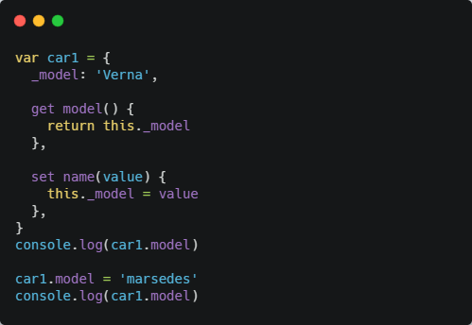
Types of Properties
There is a special syntax to define an accessor property using an
object literal:
Note that the leading underscore is a common convention to indicate that the
property is considered to be private, though in reality it is still public, and we can access it out of the object.
Developers knew that any property with leading underscore should be private so they don’t use it directly.
Accessor properties are most useful when you want the assignment of a value to trigger some sort of behavior, or when reading a value requires the calculation of the desired return value

Slide 16
Property Attributes
There ECMAScript 5 changed this by introducing several ways of interacting with property attributes directly, as well as introducing new attributes to support additional functionality.
Common Attributes
There are two property attributes shared between data and accessor properties.
- Enumerable: which determines whether you can iterate over the property.
- Configurable: which determines whether the property can be changed
Know that by default, all properties you declare on an object are both enumerable and configurable.

Slide 17
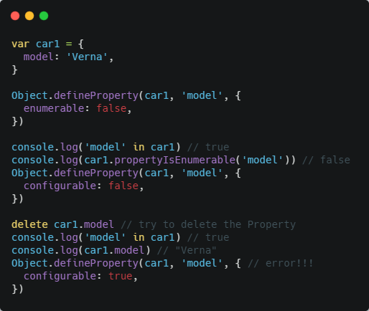
Property Attributes
If you want to change property attributes, you can use the Object.defineProperty() method. This method accepts three arguments: the object that owns the property, the property name, and a property descriptor.
When configurable set to false then trying to delete or change the value will gives an error.
Also once we set configurable to false we can’t change t later to true in the code.

Slide 18
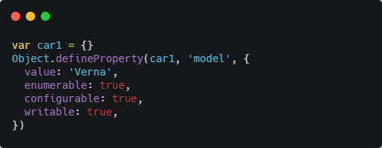
Property Attributes
Data Property Attributes
As we knew, data properties possess two additional attributes, Value which holds the property value.
And Writable which is a Boolean value indicating whether the property can be written to.
keep in mind that only the attributes you specify will
change.

Slide 19
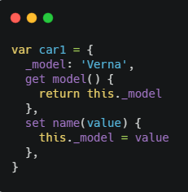
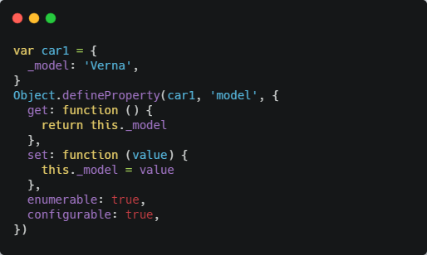
Property Attributes
Accessor Property Attributes
Accessor properties also have two additional attributes They have set and get.
Also we can do the same as following →

Slide 20
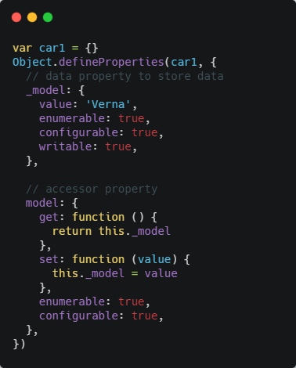
Property Attributes
Defining Multiple Properties
We can also define multiple properties on an object simultaneously if you use Object.defineProperty().
This method accepts two arguments: the object to work on and an object containing
all of the property information.

Slide 21
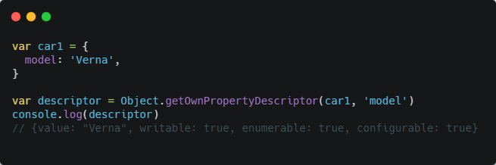
Property Attributes
Retrieving Property Attributes
If you need to fetch property attributes, you can do so in JavaScript by using Object.getOwnPropertyDescriptor(), this method works only on own properties and returns an object describing the configuration of a specific property on a given object and accepts two arguments: the object to work on and the property name to retrieve.

Slide 22
Preventing Object Modification
ECMAScript 5 introduce several methods to prevent modification of object which lock down object to ensure that no one, accidentally or otherwise, change functionality of Object.
All objects you create are extensible by default, meaning new properties can be added to
the object at any time. By setting Extensible to false, you can prevent new properties from being added to an object. There are three different ways to accomplish this.
There are three levels of preventing modification:

Slide 23
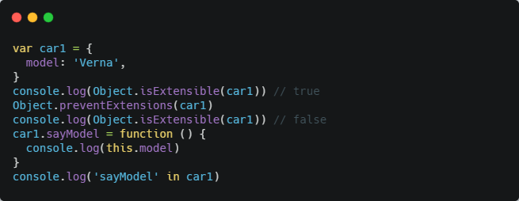
Preventing Object Modification
Preventing Extensions
With Object.preventExtensions() we prevents new properties from ever being added to an object.
This method accepts a single argument, which is the object you want to make nonextensible.
Note that once you use this method on an object, you’ll never be able to add any new properties to it again.
This piece of code checks after and before making the object extensible

Slide 24
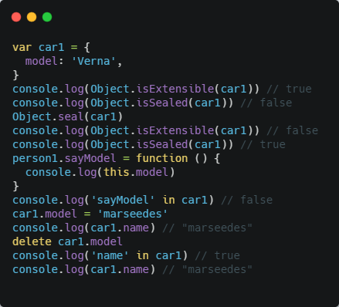
Preventing Object Modification
Sealing Objects
The Object.seal() method seals an object, preventing new properties from being added to it and marking all existing properties as non-configurable. Values of present properties can still be changed as long as they are writable.

Slide 25
Preventing Object Modification
Freezing Objects
The Object.freeze() method freezes an object. A frozen object can no longer be changed; freezing an object prevents new properties from being added to it, existing properties from being removed, prevents changing the enumerability, configurability, or writability of existing properties, and prevents the values of existing properties from being changed. In addition, freezing an object also prevents its prototype from being changed.

Slide 26
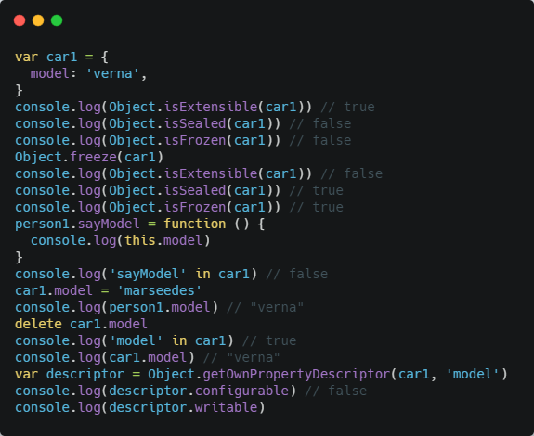
Preventing Object Modification
You can freeze an object by using Object.freeze() and determine if an object is frozen by using Object.isFrozen().

Slide 27
Alternative resources
The-principles-of-object-oriented-JavaScript (by: Nicholasc. Zakas)
https://developer.mozilla.org (MDN Web Docs)
https://www.w3schools.com
https://www.tutorialsteacher.com

Slide 28
—Thomas Jefferson
Quotes
“If you want something you have never had, you must be willing to do something you have never done.”

Slide 29

To meet again in chapter 4

